Slide 1

Prepared By: Vivek Thapliyal
Class- VI –A, Roll No.-
St. L. P. Sr. Sec. School, Dilshad Garden.

Slide 2


Slide 3

Knowing our numbers helps us in counting objects in large numbers & representing them through numerals.
Numbers helps in communicating through suitable number names & to count concrete objects.
They help us to say which collection of bigger & arrange them in order.

Slide 4

INDIAN
Period | Lakhs | Thousand | Ones
Place
Ten Lakhs | Lakhs | Ten Thousand | Thousand | Hundreds | Tens | Ones
T L | L | T Th | Th | H | T | O
For example: 9951024 can be placed in place value chart as
T L | L | T Th | Th | H | T | O
9 | 9 | 5 | 1 | 0 | 2 | 4

Slide 5
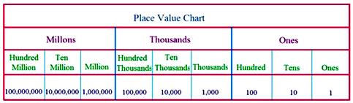
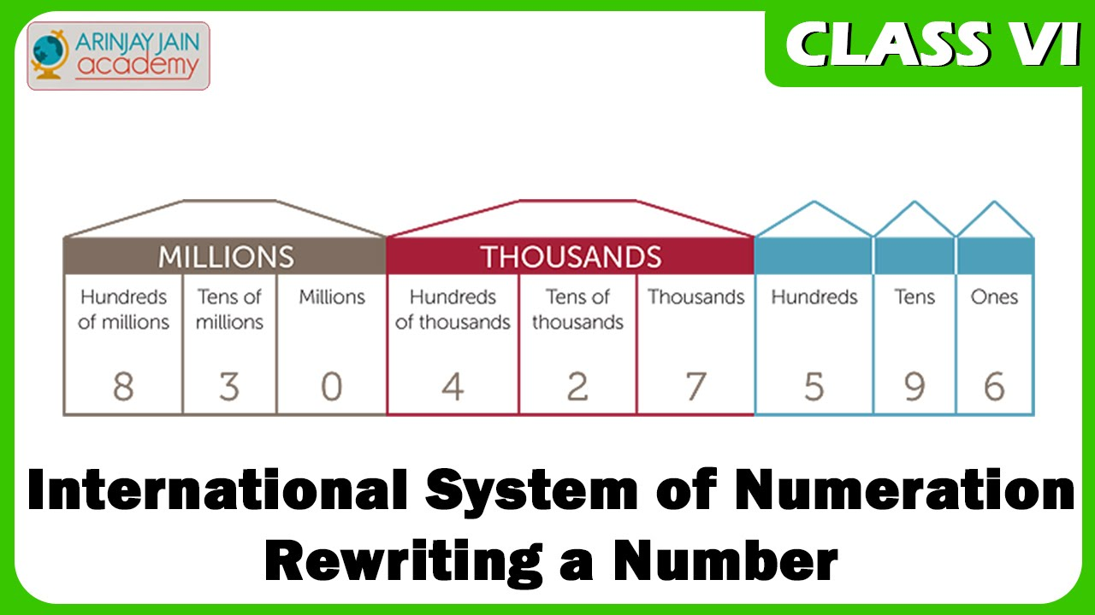

Slide 6
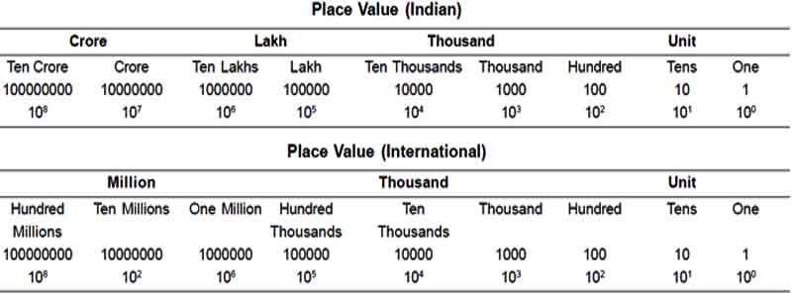
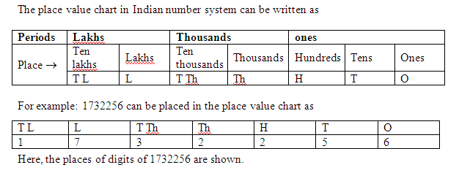

Slide 7
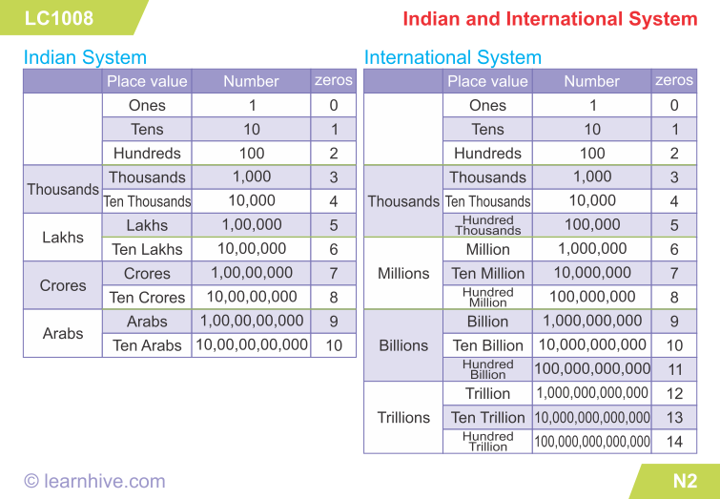
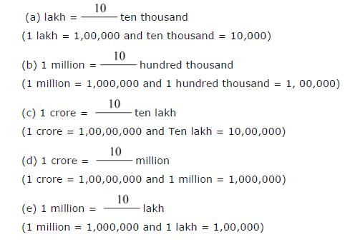

Slide 8

Period | Million | Thousand | Ones
Place
Ten Million
T M
million
M
Hundred Thousand | Ten Thousand | Thousand | Hundreds | Tens | Ones
L | T Th | Th | H | T | O
For example: 96743682 can be placed in place value chart as
T M | M | H Th | T Th | Th | H | T | O
9 | 6 | 7 | 4 | 3 | 6 | 8 | 2

Slide 9

In order to compare two numbers, we adopt the following rulers:-
RULE 1:- The number with less digits is less than the number with more digits.
RULE 2:- Suppose we have to compare two numbers having the same numbers of digits than we proceed as under
Step 1- First compare the digits at the leftmost place in both the numbers.
Step 2- If they are equal in value then compare the second digits from the left.
Step 3- if the second digits from the left are equal then compare the third digits from the left.
Step 4- continue until you come across unequal digits at the corresponding places. Clearly, the number with greater such digit is the greater of the two.

Slide 10

Eg.1- which is greater: 24576813 or 9897686?
Sol.- A number with more digits is greater
so, 24576813>9897686
Eg.2- which is smaller: 1003467 or 987965?
Sol.- A number with less digits is smaller
so, 1003467<9897965
Eg.3- Arrange the following in ascending order:
3763214, 18340217, 984671, 3790423
Sol.- 984671<3763214<3790423<18340217
Eg.4- Arrange the following in descending order:
63872604, 4965328, 63890503, 5023145
Sol.- 63890503>63872604>5023145>4965328

Slide 11
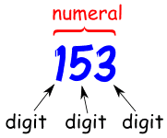
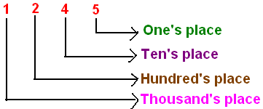
Numeral Form of Numbers
A number written such that each digit has a place value according to its position in relation to other digits. Example: Write the number seven thousand, three hundred, sixty-four as a standard numeral and in expanded form.
Numeral : A numeral is a symbol or name that stands for a number.
Examples: 3, 49 and twelve are all numerals.
So the number is an idea, the numeral is how we write it.
Digit : A digit is a single symbol used to make numerals.
0, 1, 2, 3, 4, 5, 6, 7, 8 and 9 are the ten digits we use in everyday numerals.
Example: The numeral 153 is made up of 3 digits ("1", "5" and "3").
Example: The numeral 46 is made up of 2 digits ("4", and "6").
Example: The numeral 9 is made up of 1 digit ("9"). So a single digit can also be a numeral .

Slide 12

Expanded Form
When we write the number 521, what that number really means is that we have the total of 500 + 20 + 1. We've expanded the number to show the value of each of its digits. When we expand a number to show the value of each digit, we're writing that number in expanded form.
Expanding Brackets
If we have a number, or a single algebraic term, multiplying bracketed terms, then all terms in the brackets must be multiplied as shown in the following examples. The 3 outside must multiply both terms inside the brackets.
Example 3(x +2)=3x + 6.

Slide 13

Rounding a number to the nearest ten
Step 1- See the ones digit of the given number.
Step 2- If ones digit is less than 5, replace ones digit by 0, & keep the other digits as they are.
Step 3- If ones digit is 5, increase tens digit by 1, & replace ones digit by 0.
EXAMPLE:- In 53, the ones digit is 3<5
so, the required rounded number is 50

Slide 14
Rounding a number to the nearest hundred
Step 1- See the tens digit of the given number.
Step 2- If tens digit is less than 5, replace each one of tens & ones digits by 0, & keep the other digits as they are.
Step 3- If this digit is 5 or more, increase hundreds digit by 1 & replace each digit on its right by 0.
EXAMPLES:- In 648, the tens digit is 4<5
So, the required rounded number is 600

Slide 15
Rounding a number to the nearest thousand
Step 1- See the hundreds digit of the given number.
Step 2- If hundreds digit is less than 5, replace each one of hundreds, tens & ones digits by 0, & keep the other digits as they are.
Step 3- If hundreds digit is 5 or more, increase thousands digit by 1 & replace each digit on its right by 0.
EXAMPLE:- In 5486 the hundreds digit is 4<5
So, the required rounded number is 5000

Slide 16

One of the early systems of writing numerals is the system of roman numerals.
There are seven basic symbols to write any numeral.
These symbols are given below:-
ROMAN NUMERAL | I | V | X | L | C | D | M
HINDU-ARABIC NUMERAL | 1 | 5 | 10 | 50 | 100 | 500 | 1000
EXAMPLE:- CXIV= 100+ 10+(5-1)= 114
XL= (50-10)= 40

